Slide 1


CUSTOMER RETENTION

Slide 2



Powerpoint
presentation
Indian-e commerce
Customer_Retention
Search:
Problem Statement : Customer Retention
# Project title , problem statement :
Project Title : Customer_Retention
Problem Statement:
Customer satisfaction has emerged as one of the most important
factors that guarantee the success of online store; it has been
posited as a key stimulant of purchase, repurchase intentions and
customer loyalty. A comprehensive review of the literature,
theories and models have been carried out to propose the models
for customer activation and customer retention.
.Five major factors that contributed to the success of an e-commerce
store have been identified as:
.service quality,
.system quality,
.information quality,
.trust and net benefit.
The research furthermore investigated the factors that influence
the online customers repeat purchase intention. The combination
of both utilitarian value and hedonistic values are needed to affect
the repeat purchase intention (loyalty) positively. The data is
collected from the Indian online shoppers. Results indicate the e-retail
success factors, which are very much critical for customer satisfaction.

Slide 3

Loading the essential libraries
import pandas as pd
import numpy as np
import seaborn as sns
import warnings
warnings.filterwarnings('ignore')
Import pandas as pd
Import numpy as np
Import matplotlib.pyplot as plt
Import seaborn as sns
Import warnings
Warnings.fiterwarnings (‘ignore’)
df = pd.read_excel
( ‘customer_retention .xlsx’ )
df

Slide 4

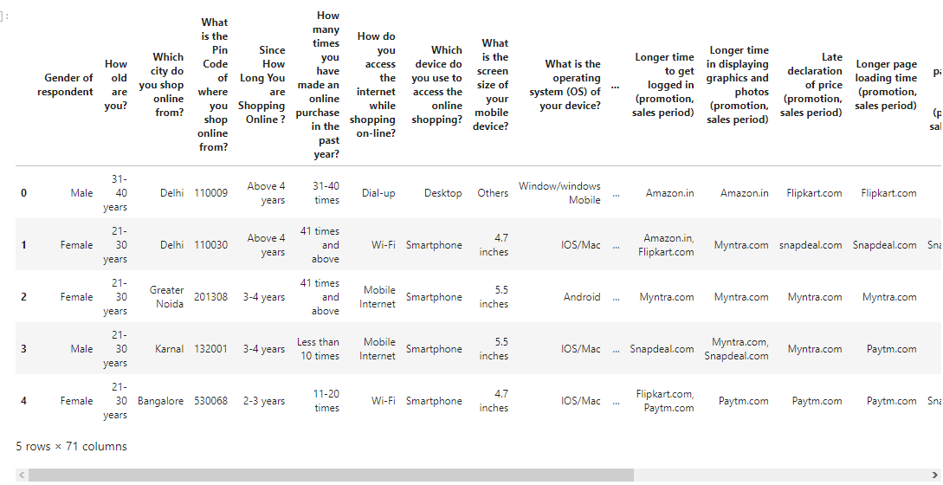
CUSTOMER RETENTION - DATASET

Slide 5
Total SHAPE OF THE DATASET
269
Rows
71
Columns

Slide 6


. What is the datatype of our dataset???
-All the columns are of object datatype except for pincode column which is of int type.
Gender of respondent object How old are you? object
Which city do you shop online from? Object What is the Pin Code of where you shop online from? - Int64
Since How Long You are Shopping Online ? object Longer delivery period object
Change in website/Application design object Website is as efficient as before object
Frequent disruption when moving from one page to another ----------------------------- ------------------ > object
Which of the Indian online retailer would you recommend to a friend? -------------------------------------------------> object

Slide 7

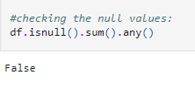
CHECKING - “NULL VALUES”
.There is no null value present in the dataset.

Slide 8

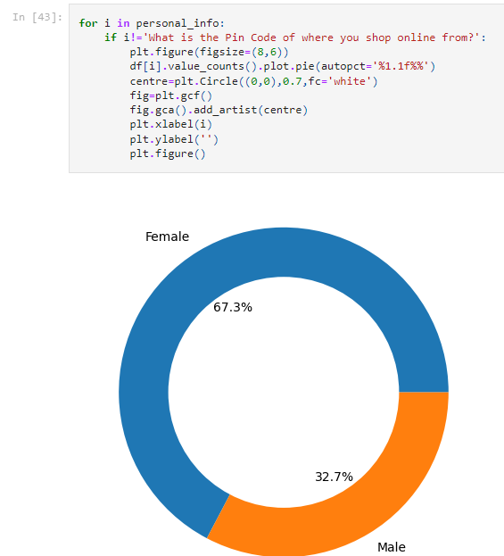

Personal Information
Univariate Analysis:
personal_info = [ 'Gender of
respondent',‘ How old are you?',
'Which city do you shop online from?',
'What is the Pin Code of where you shop online from?',
'Since How Long You are Shopping Online ?',
'How many times you have made an online purchase in the past year?‘ ]
We can see in the figure:
Gender of respondent:

Slide 9

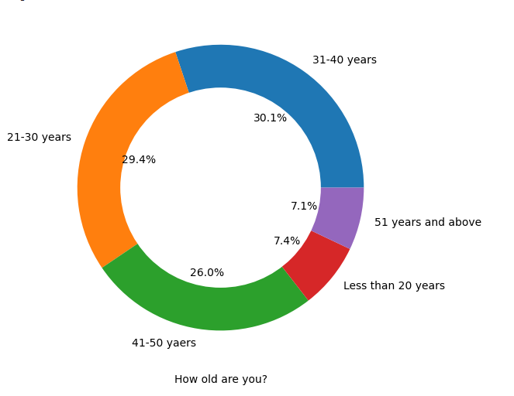
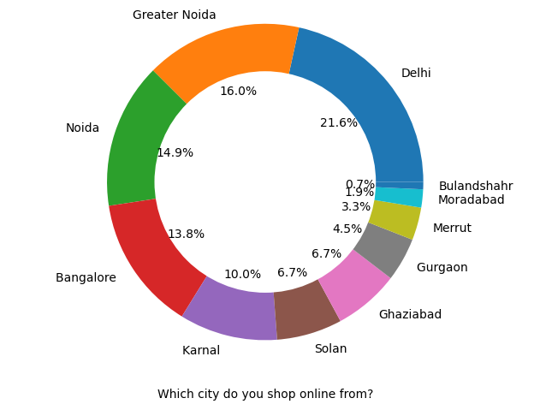
How old are you,which city do you shop from?

Slide 10
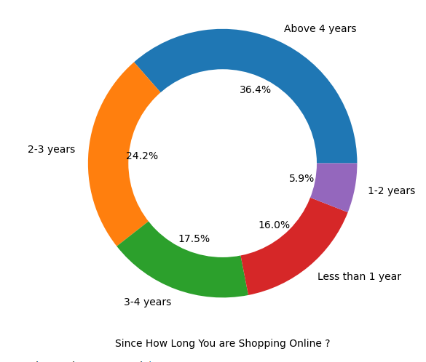
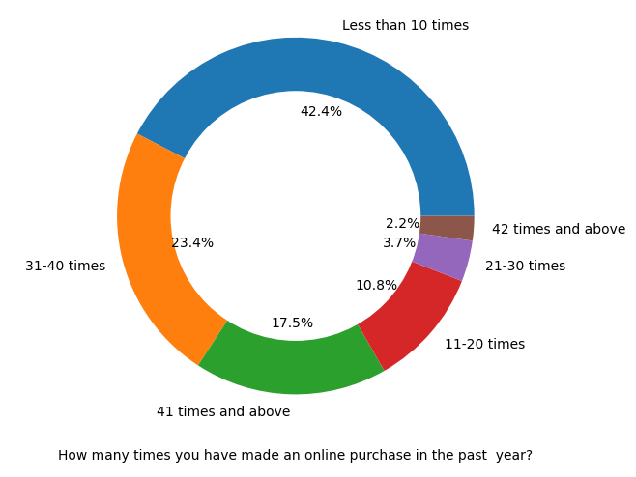
Since how long / How many times you have made an online purchase in the past year?

Slide 11

CONCLUSION
There is double the no. of women that men who have taken this survey.
Most of the people are in their 30’s follwed b y20’s ,teenagers and senior citizen are the least in number.
Most of the people belong from delhi, noida and banglore.
Ambiguity can also be seen in noida has two categories (noida and grater noida) which needs to be handled ,
Most of the people shopping online have been shopping for long time.
Majority of people shop online 10 times a year.
Amiguity can also be seen for range 42 times and above which needs to be handled.

Slide 12
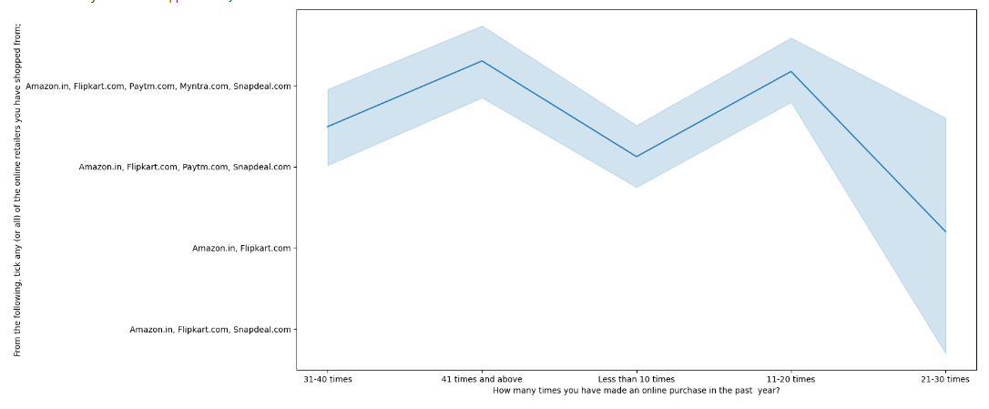
Analysis on the basis of Various following factors:
#Intention of Repeat purchase:
#Resolving ambiguity of column
#Changing 42 times and above to 41 times and above
df['How many times you have made an online purchase in the past year?'].replace('42 times and above','41 times and above', inplace=True)
plt.figure(figsize=(15,8))
sns.lineplot(df['How many times you have made an online purchase in the past year?'], df['From the following, tick any (or all) of the online retailers you have shopped from;'])
Conclusion:
-Heavy shoppers who shop more than 41 times a year shop from all the online brands,
some of the people who shop for 32-40 and less than 10 times a year seem to exclude myntra. People shop from Amazon and flipkart whatever be the case.

Slide 13

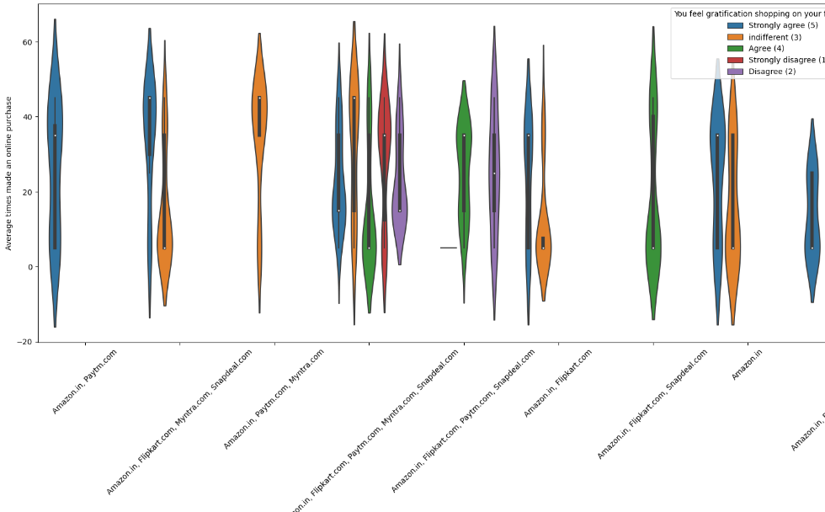
CONVERTING YEARS TO NUMBERS FOR BETTER ANAYSIS
CONVERTING YEARS TO NUMBERS FOR BETTER ANAYSIS:
dict={'31-40 times':35,'41 times and above':45,'Less than 10 times':5,'11-20 times':15,'21-30 times':25}
df['Average times made an online purchase']=df['How many times you have made an online purchase in the past year?'].replace(dict)
Violinplot:
plt.figure(figsize=(20,8)) sns.violinplot (df['From the following, tick any (or all) of the online retailers you have shopped from;'], df['Average times made an online purchase'],hue=df['You feel gratification shopping on your favorite e-tailer']) plt.xticks(rotation=45)
Conclusion:-Almost all the people who have shopped from amazon, flipkart and paytm are satisfied. -People who shop from a more number of online brands dosent seem to be satisfied.

Slide 14

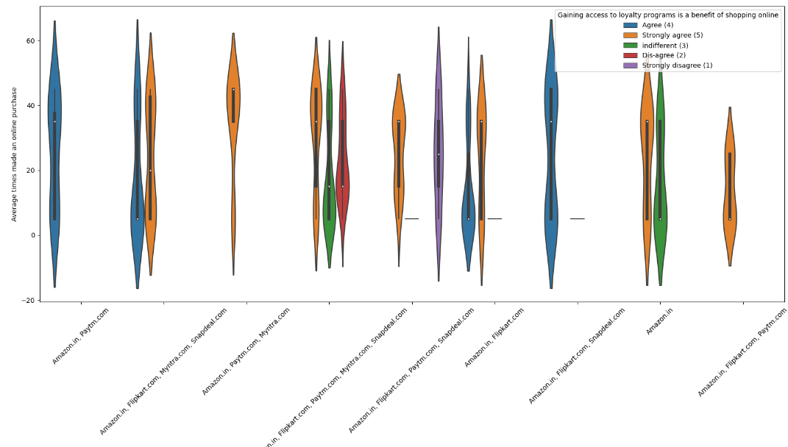
VIOLINPLOT
plt.figure(figsize=(20,8)) sns.violinplot(df['From the following, tick any (or all) of the online retailers you have shopped from;'], df['Average times made an online purchase'],hue=df['Gaining access to loyalty programs is a benefit of shopping online']) plt.xticks(rotation=45)
CONCLUSION:
-People shopping from amazon and paytm are getting benefits from the loyalty points, -flipkart and sanpdeal also seem to give such benefits but people who shop from almost everywhere disagree with this statement too.

Slide 15
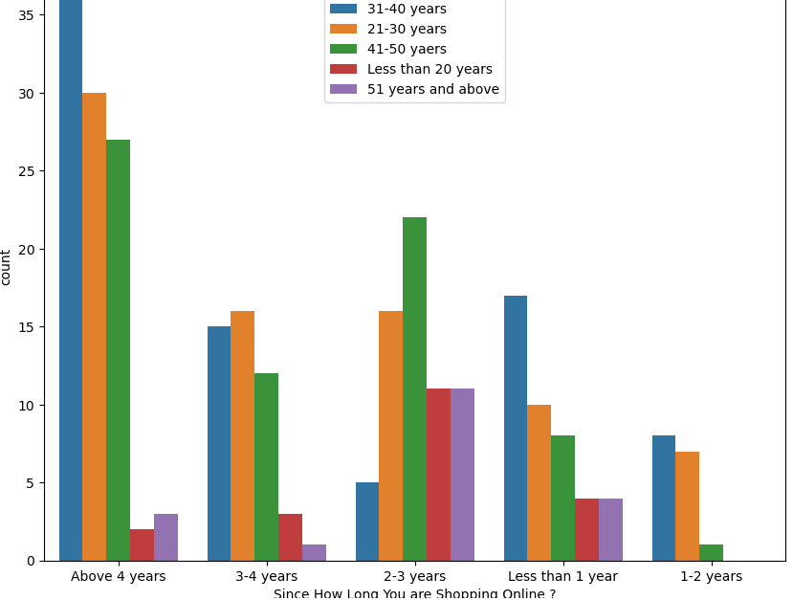
Online Retailing:
Countplot:
plt. figure ( figsize = (10,8) ) sns. Countplot ( df [
'Since How Long You are Shopping Online ?'] ,
hue=df['How old are you?'])
CONCLUSION:
Highest number of people have been shopping
online for above 4 years except for the age group
below 20 years and above 50 years. People who are
shopping online for 1-2 years does not include
teenagers and elder people.

Slide 16

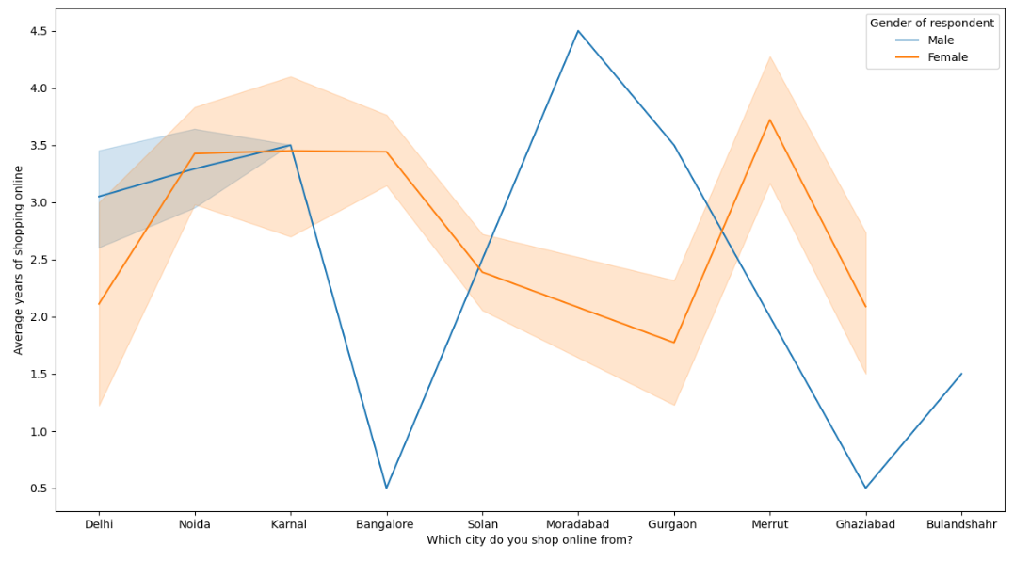
LINE PLOT :
lineplot:
plt.figure(figsize=(15,8))
sns.lineplot (df ['Which city do you shop
online from?'], df['Average years of shopping
online'], hue=df['Gender of respondent'])
CONCLUSION:
-In lines, we can see that density of female
customers is more than male. -Men living in
banglore and ghaziabad shop have shopped
online for less than 1 year. -Highest number
of men shopping online belong from delhi
and noida, -while men from moradabad have
been shopping online for the longest. –
Women from meerut and noida have
shopped the longest.

Slide 17
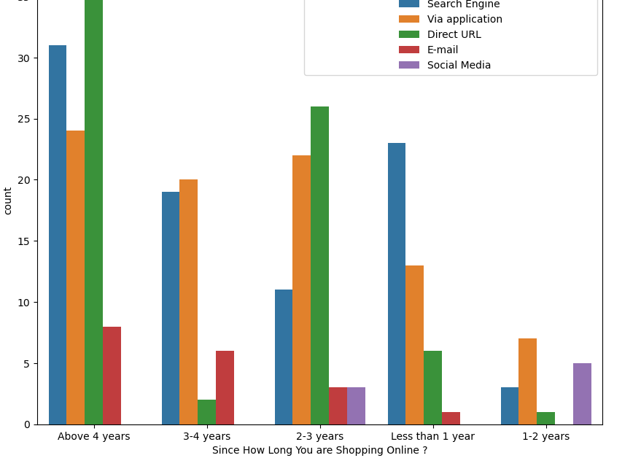
COUNTPLOT
COUNTPLOT
plt.figure ( figsize = (10,8) ) sns.countplot( df
['Since How Long You are Shopping Online
?'], hue = df ['After first visit, how do you
reach the online retail store?'])
CONCLUSION:
-Even though people who are shopping online for more than 3 years donot use the application rather use search engine and -direct url's in large number which indicates that online brands should update all their platforms rather than just application.

Slide 18

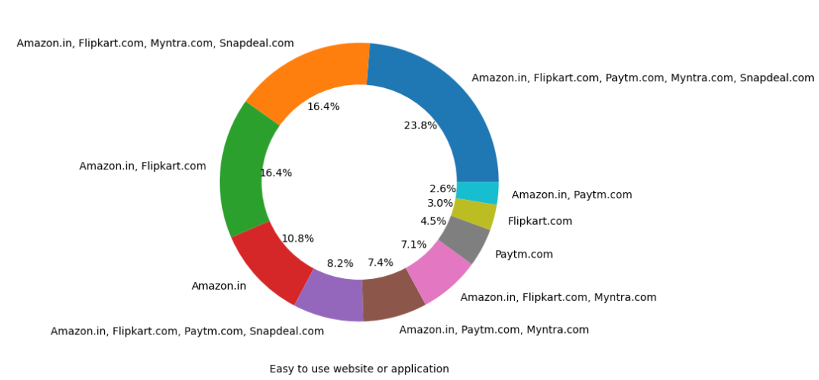
BRAND IMAGE
Easy to use website/Application:
Performance = ['Easy to use website or application', 'Visual appealing web-page layout', 'Wild variety of product on offer', 'Complete, relevant description information of products', 'Fast loading website speed of website and application', 'Reliability of the website or application', 'Quickness to complete purchase', 'Availability of several payment options', 'Speedy order delivery', 'Privacy of customers’ information', 'Security of customer financial information', 'Perceived Trustworthiness', 'Presence of online assistance through multi-channel']
for i in performance:
plt.figure(figsize=(8,6)) df[i].value_counts().plot.pie(autopct='%1.1f%%') centre=plt.Circle((0,0),0.7,fc='white') fig=plt.gcf() fig.gca().add_artist(centre) plt.xlabel(i) plt.ylabel('') plt.figure()

Slide 19
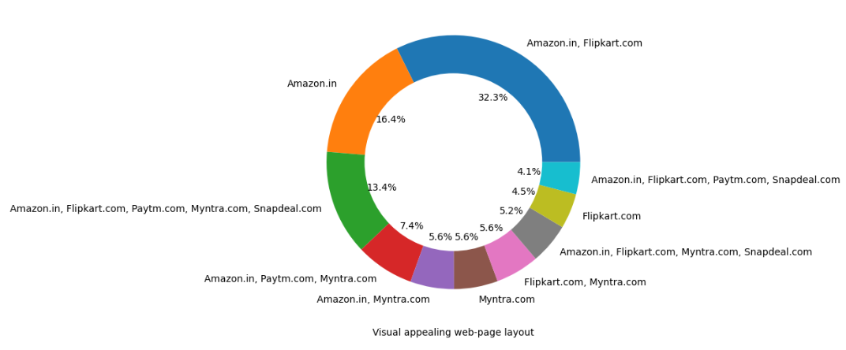
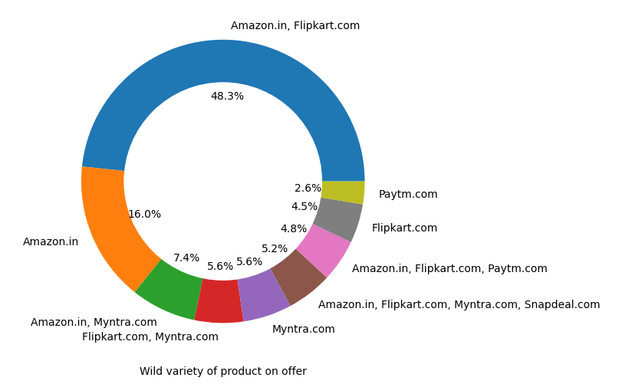
Visual appearing webpage layout,wild variety of product on offer

Slide 20
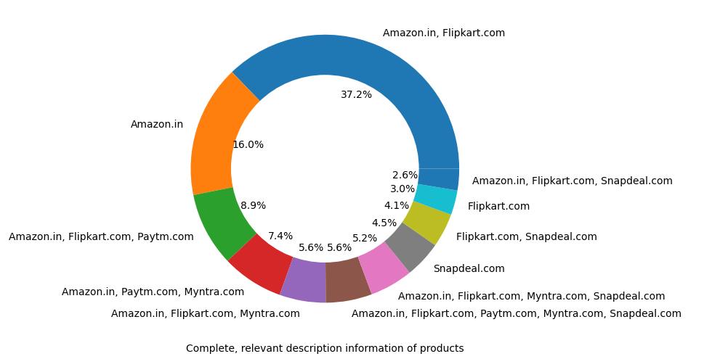
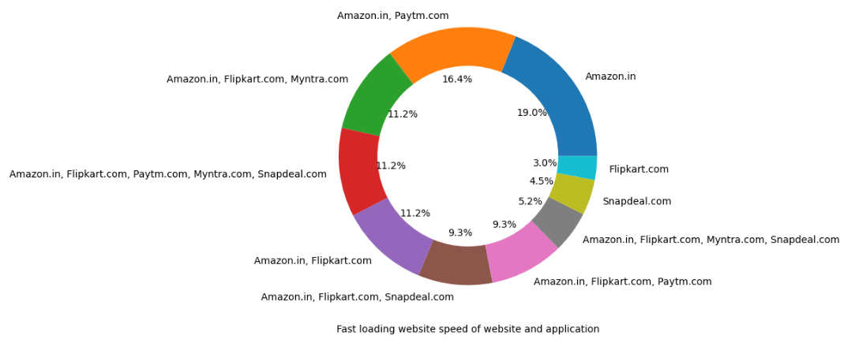
Complete relevant description information of products,Fast loading website speed of website and application.

Slide 21
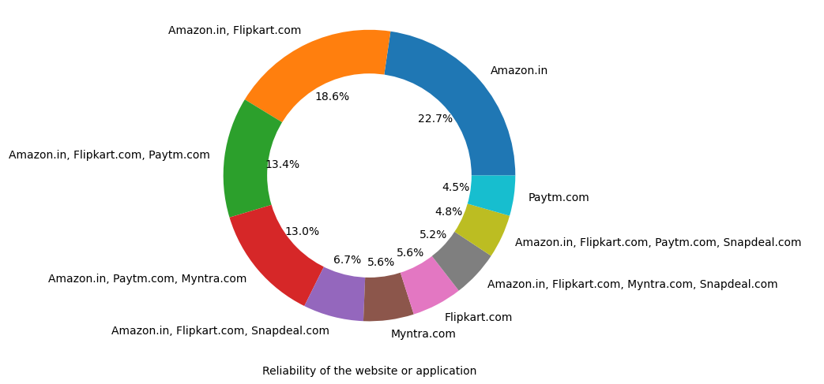
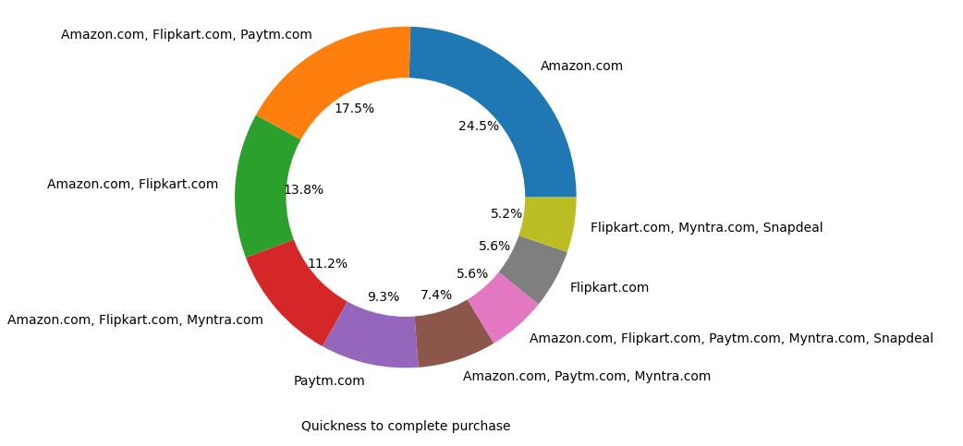
Reliability of the website or the application,Quickness to complete purchase

Slide 22
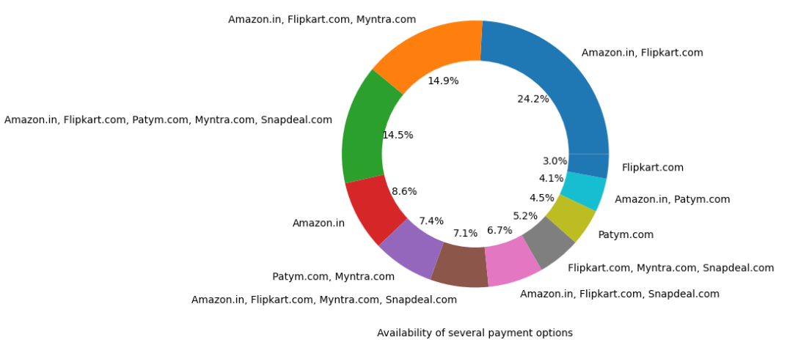
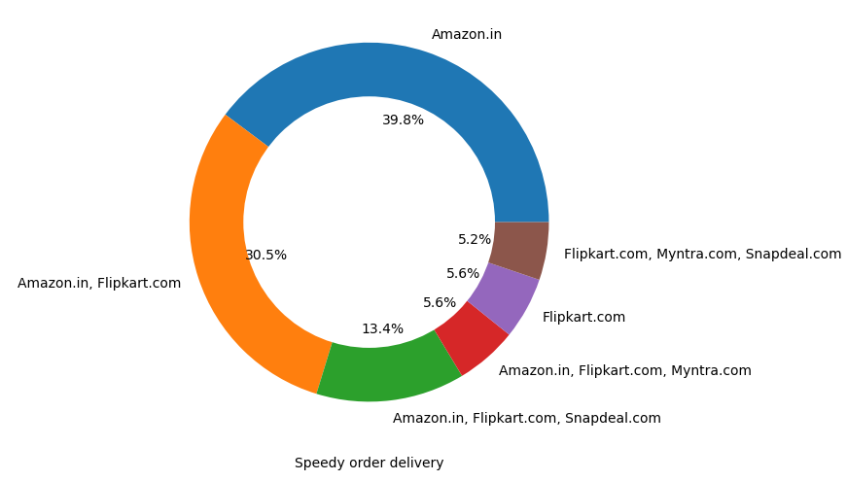
‘Availability of several payment options', 'Speedy order delivery’

Slide 23
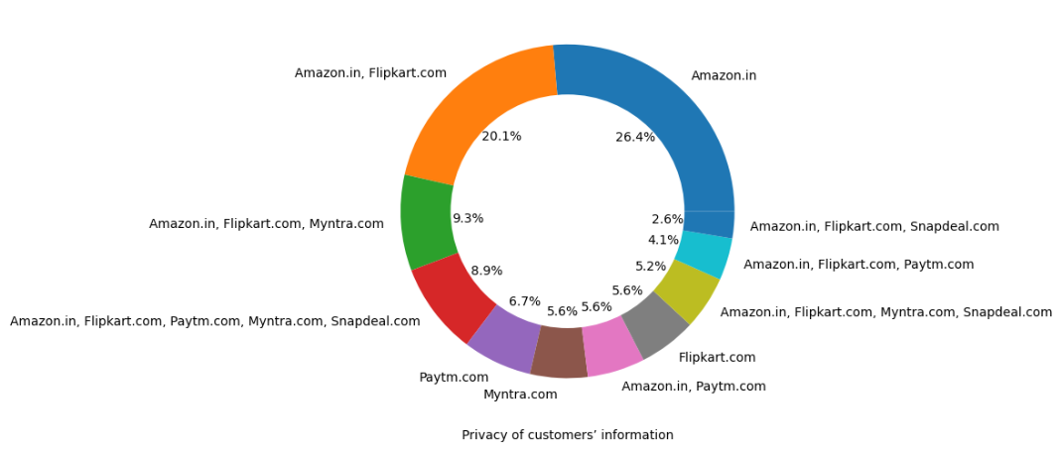
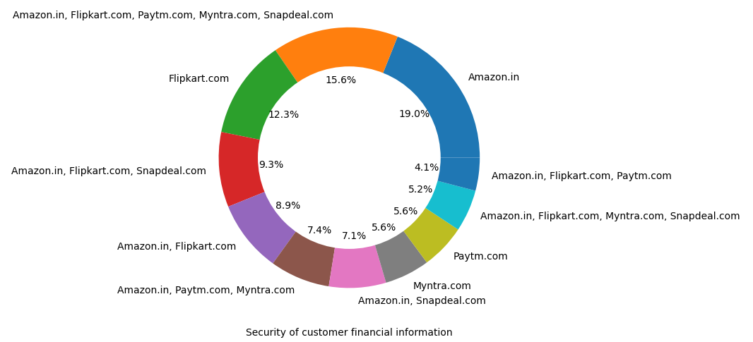
Privacy of customers’ information,Security of customer financial information

Slide 24
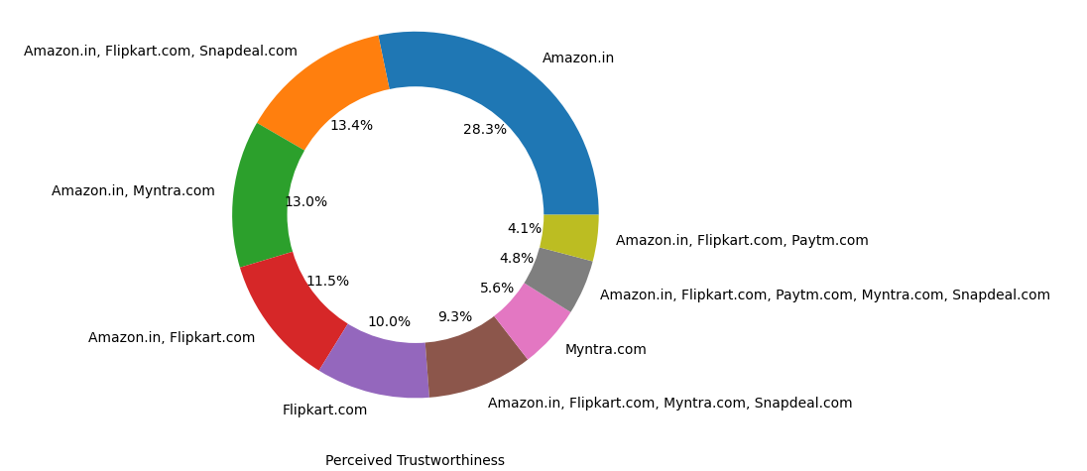
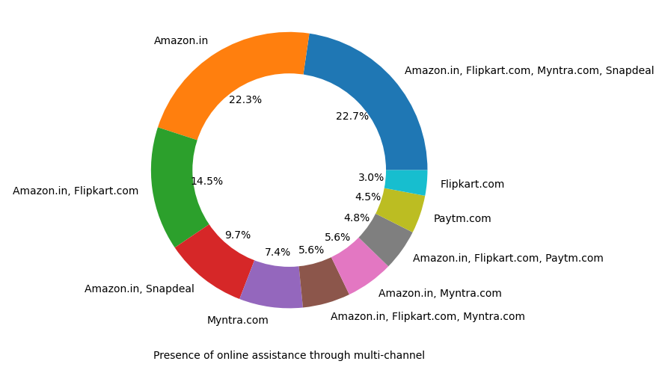
‘Perceived Trustworthiness', 'Presence of online assistance through multi-channel’

Slide 25
CONCLUSION :
-Amazon, Flipkart have been had the
highest votes for having all the
positive points and have maintained a
very good brand image -followed by
paytm and the myntra.

Slide 26

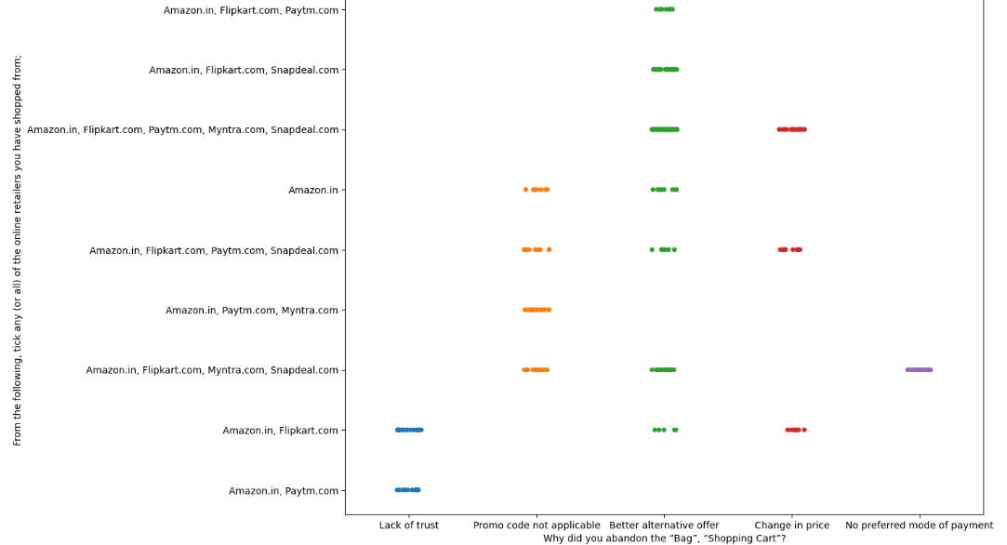
STRIPPLOT :
STRIPPLOT :
plt.figure (figsize=(12,10)) sns.stripplot (df ['Why did you abandon the “Bag”,“Shopping Cart”?'] ,df ['From the following, tick any (or all) of the online retailers you have shopped from;‘ ])
CONCLUSION :
-We can clearly see that most of the time people abandon the bag is beacuse they get a better alternative offer -or promo code not applicable. There is also lack of trust seen in amazon, flipkart and paytm by some people.

Slide 27


LOYALTY OF CUSTOMERS

Slide 28
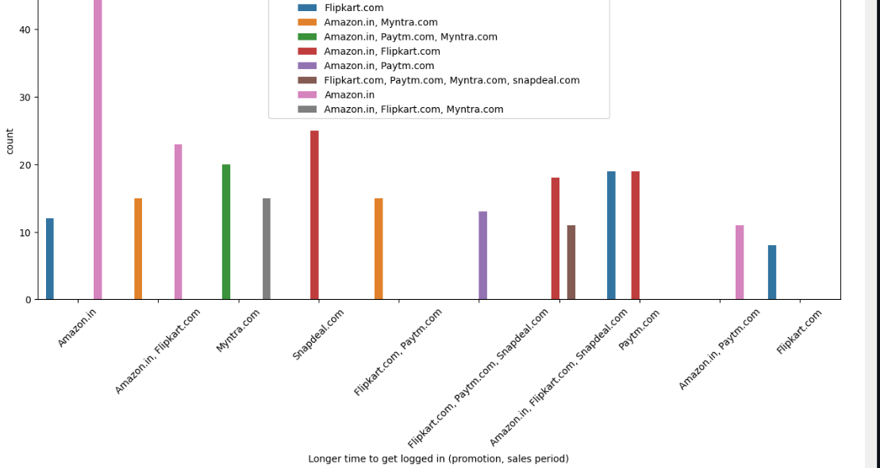
Longer time to get logged in (promotion,sales period)
#Loyal customers are those who keep using the same brand even if it is not good as other brands
#Collecting all the negative remarks about a brand.
bad=['Longer time to get logged in (promotion, sales period)', 'Longer time in displaying graphics and photos (promotion, sales period)', 'Late declaration of price (promotion, sales period)', 'Longer page loading time (promotion, sales period)', 'Limited mode of payment on most products (promotion, sales period)', 'Longer delivery period', 'Change in website/Application design', 'Frequent disruption when moving from one page to another']
# countplot:
for i in bad: plt.figure(figsize=(15,6)) sns.countplot(df[i],hue=df['Which of the Indian online retailer would you recommend to a friend?']) plt.xticks(rotation=45) plt.figure()

Slide 29
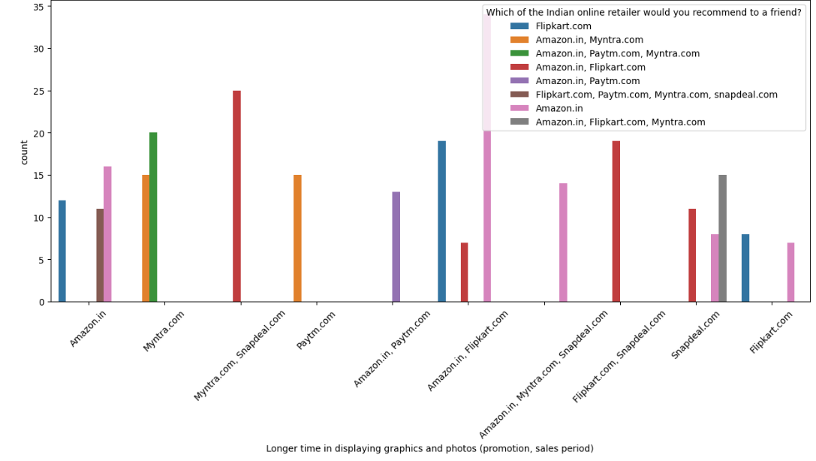
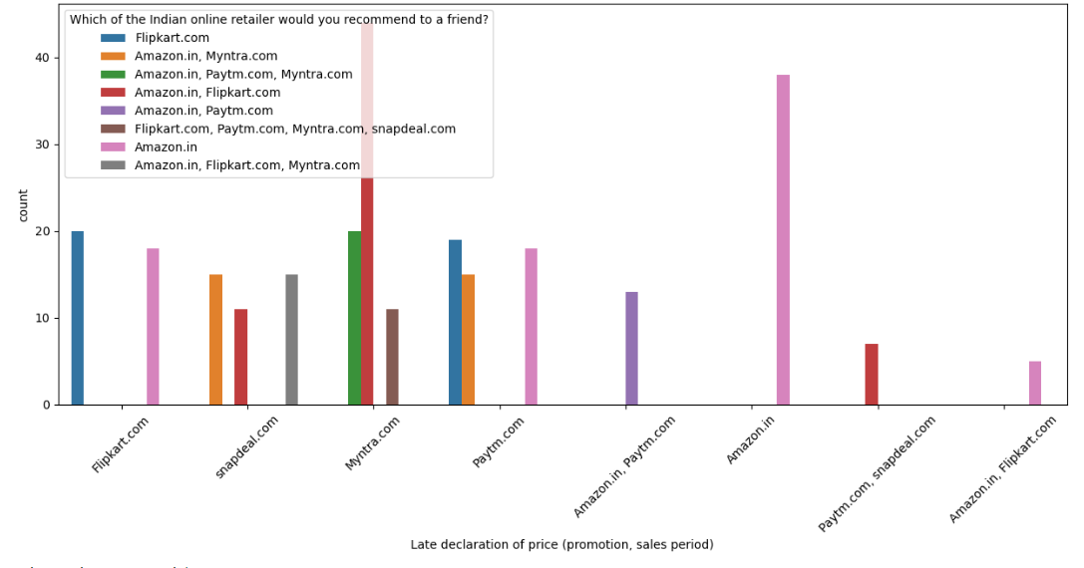
COUNTPLOT
'Longer time to get logged in (promotion, sales period)',
'Longer time in displaying graphics and photos (promotion, sales period)'

Slide 30
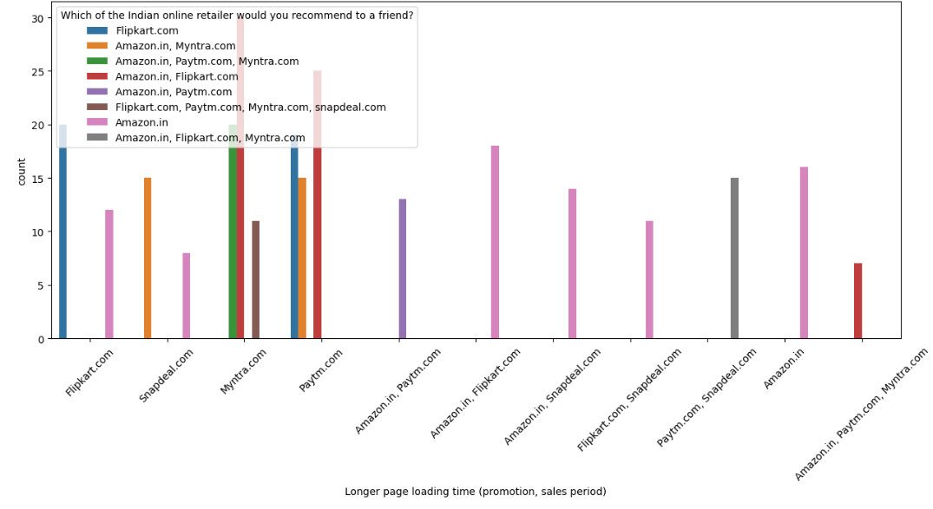
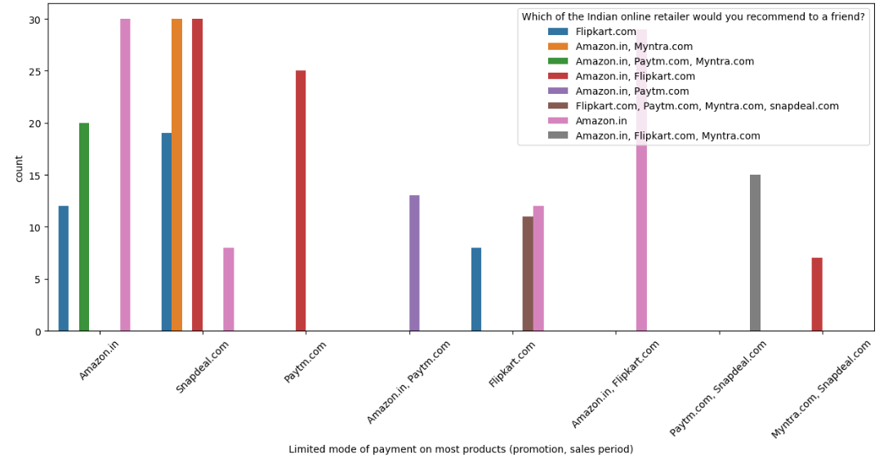
COUNTPLOT
'Longer page loading time (promotion, sales period)',
'Limited mode of payment on most products (promotion, sales period)'

Slide 31
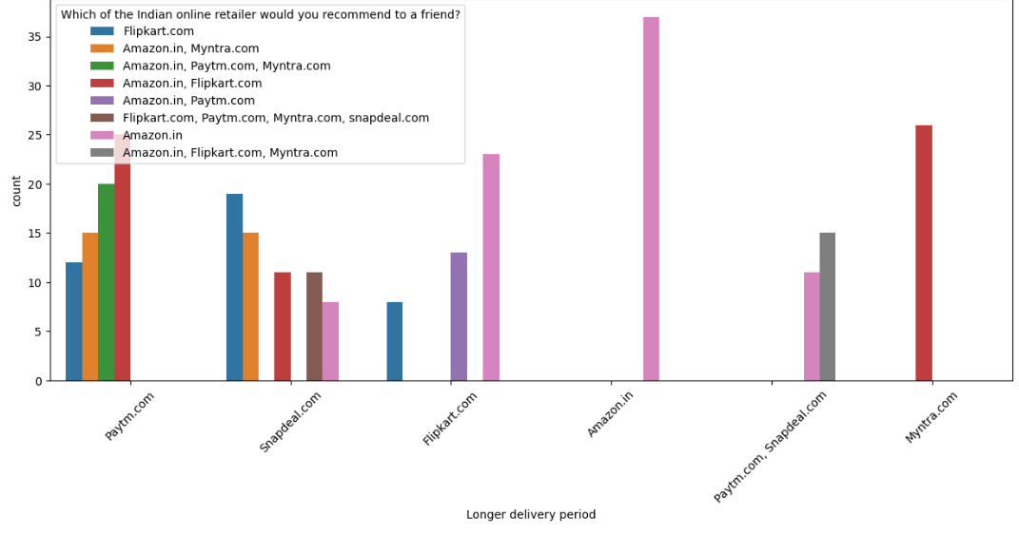
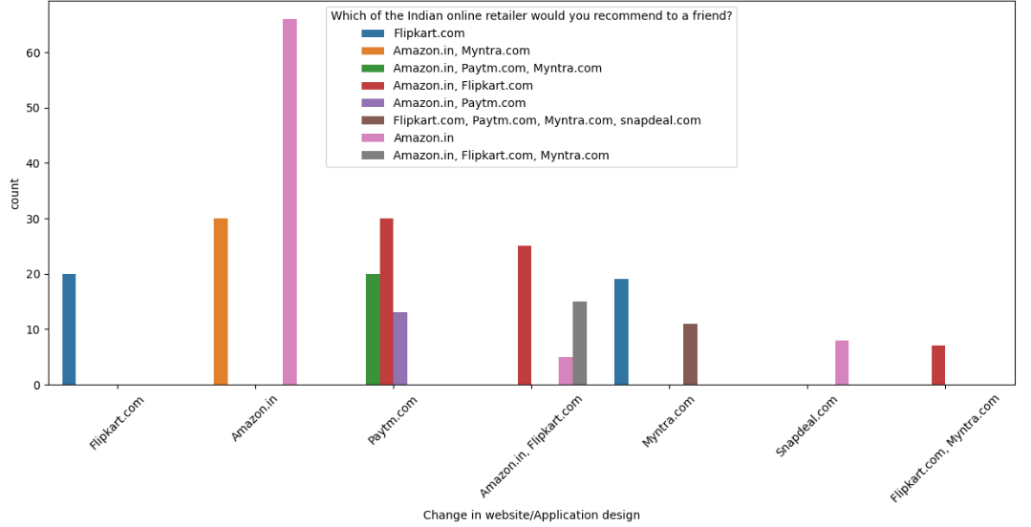
COUNTPLOT
'Longer delivery period',
'Change in website/Application design'

Slide 32
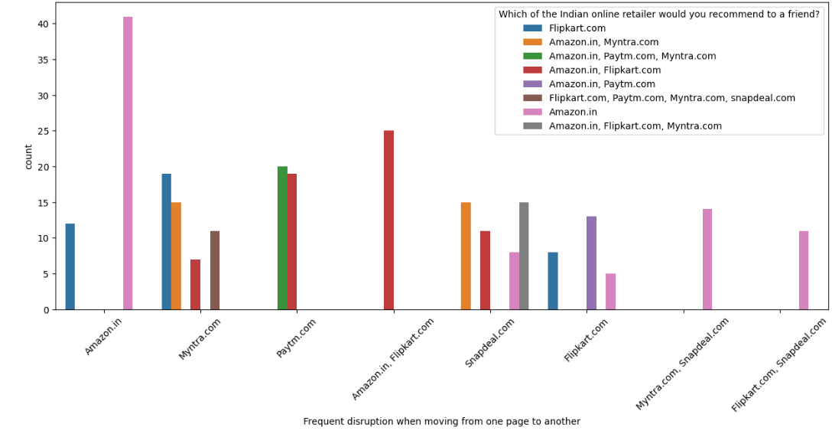
COUNTPLOT
'Frequent disruption when moving from one page to another'

Slide 33

LOYALTY OF CUSTOMERS :
CUNCLUSION :
-Customers seem to be
more loyal to amazon,
flipkart and paytm as even
though many of them have
given negative remarks
about -them still they
would recommend these
platforms to their friend

Slide 34
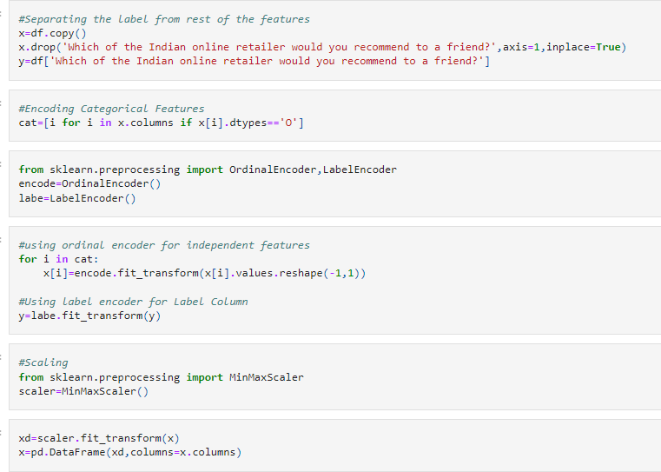
Processing the dataframe:

Slide 35
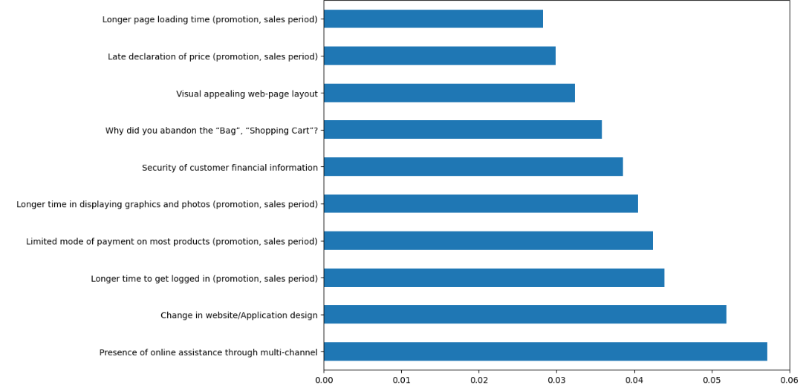

Using various feature selection method to see which feature affects the most:
#Using Feature importance of random forrest
from sklearn.ensemble import RandomForestClassifier
m=RandomForestClassifier()
m.fit(x,y)
=>RandomForestClassifier()
#plot graph of feature importances for better visualization
feat_importances = pd.Series(m.feature_importances_,
index=x.columns)
plt.figure(figsize=(10,8))
feat_importances.nlargest(10).plot(kind='barh') plt.show()
CONCLUSION:
-In the above chart we can see that above features are of most importance in determining which platform will a customer recommend to his friend.

Slide 36
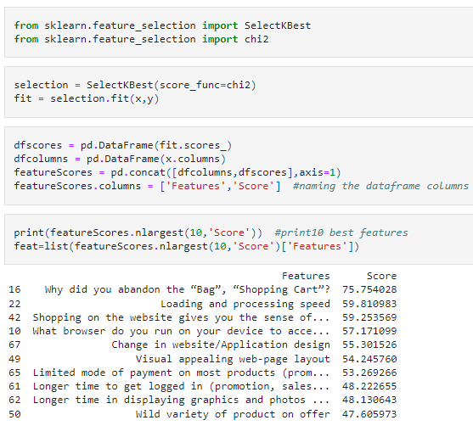
Using chi2 test:

Slide 37

Modelling phase:

Slide 38
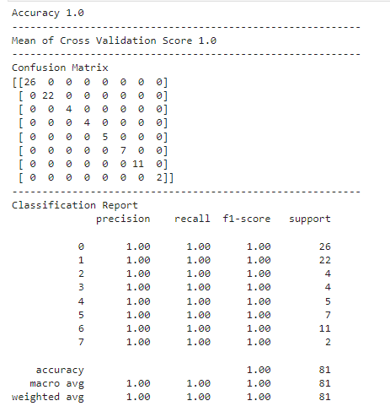

MODELLING PHASE :
#Modelling Phase
From sklearn.model_selection import train_test_split,cross_val_score from sklearn.ensemble import RandomForestClassifier
from sklearn.metrics import accuracy_score,confusion_matrix,
classification_report,roc_auc_score,roc_curve
xtrain,xtest,ytrain,ytest=train_test_split(x,y,test_size=0.3,random_state=7)
#Random Forest model=RandomForestClassifier()
model.fit(xtrain,ytrain) p=model.predict(xtest) s=cross_val_score(model,x,y,cv=10)
print('Accuracy',np.round(accuracy_score(p,ytest),4))
print('----------------------------------------------------------')
print('Mean of Cross Validation Score',np.round(s.mean(),4))
print('----------------------------------------------------------')
print('Confusion Matrix') print(confusion_matrix(p,ytest))
print('----------------------------------------------------------')
print('Classification Report') print(classification_report(p,ytest))

Slide 39
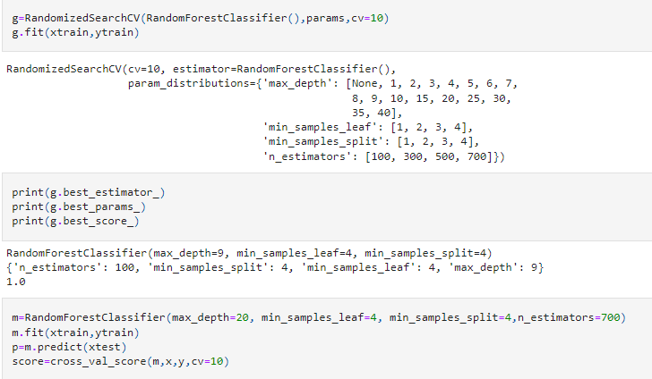
HYPERPARAMETER
TUNNING
#Hyperparameter Tuning
from sklearn.model_selection import RandomizedSearchCV
#Random Forest
params={'n_estimators':[100, 300, 500, 700],
'min_samples_split':[1,2,3,4], 'min_samples_leaf':[1,2,3,4],
'max_depth':[None,1,2,3,4,5,6,7,8,9,10,15,20,25,30,35,40]}

Slide 40
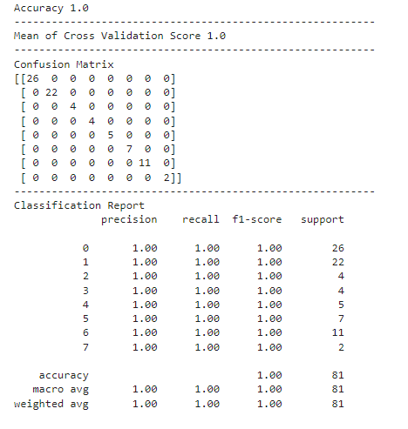
HYPERPARAMETER
TUNNING ……
print('Accuracy',np.round(accuracy_score(p,ytest),4))
print('----------------------------------------------------------')
print('Mean of Cross Validation Score',np.round(s.mean(),4))
print('----------------------------------------------------------')
print('Confusion Matrix') print(confusion_matrix(p,ytest))
print('----------------------------------------------------------')
print('Classification Report') print(classification_report(p,ytest))

Slide 41


SAVING
MODEL :
#Saving the Model
import joblib
joblib.dump(model,'Retention.object')
['Retention.object']

Slide 42
OVERALL CONCLUSION :
The results of this study suggest following outputs which might be useful for E-commerce websites to extend their business -The cost of the product, the reliability of the E-commerce company and the return policies all play an equally important role -in deciding the buying behaviour of online customers. The cost is an important factor as it was the basic criteria used by -online retailers to attract customers. The reliability of the E-commerce company is also important, as it is even required -in offline retail. It is important because customers are paying online, so they need to be sure of security of the online -transaction. The return policies are important because in online retail customer does not get to feel the product. -Thus, he wants to be sure that it will be possible to return the product if he does not like it in real. Whereas, -the logistics factor, which included Cash on delivery option, One day delivery and the quality of packaging plays a secondary -role in this process though these are Must-be-quality. This is so because these all does not interfere with the real product -and people believe that this is the basic value that E-commerce websites provide. -All the websites were not equally preferred by online customers. Amazon was the most preferred followed by Flipkart. -This can be explained easily by previous result that we got. These two companies are most trusted in the industry and hence, -have a huge reliability. Also, the sellers listed on these websites are generally from Tier 1 cities as compared to Snapdeal -and PayTM which have more sellers from tier 2 and 3 cities. Also, these websites have the most lenient return policies as -compared to others and also the time required to process a return is low for these.

Slide 43

Indian-e-Commerce Customer_Retention

